Slide 1
Video game Sales
By
Selvasridevi S
EBEON0623809572

Slide 2
Agenda
Introduction
Data set Overview
Machine Learning
Algorithms used in the project
Project steps
Data Visualization
Accuracy Table
Conclusion

Slide 3
Introduction
Playing Video games is all about Entertainment.But what if we take it as study content?....
Here our project is all about Video game Sales.Video game sales analysis is done by using Machine Learning.
We have taken a Dataset from Kaggle Website.

Slide 4
Data Set Overview
DataSet : https://www.kaggle.com/datasets/gregorut/videogamesales
Rank : Sales Rank
Name : Name of the Game
Platform : Release Platform for the game
Year : Year of Release
Genre : Game genre
Publisher : Company which released the game
NA_Sales : North American Sales in Million
EU_Sales : European Sales in Million
JP_Sales : Japan Sales in Million
Other_Sales : Sales in other Countries Million
Global_Sales : Sales around the world in Million

Slide 5
Machine Learning
Machine learning is simply the study of a computer program or algorithm on how to progressively improve upon a set task that it is given.
Types of Machine Learning :
1. Supervised
2. Semi Supervised
3. Unsupervised
4. Reinforcement

Slide 6
Algorithms used in the Project
Linear Regression
Decision Tree
Random Forest
KNN

Slide 7
Project Steps
Importing Libraries
Data Cleaning
Data Visualization
Machine Learning Algorithms
Predictions

Slide 8
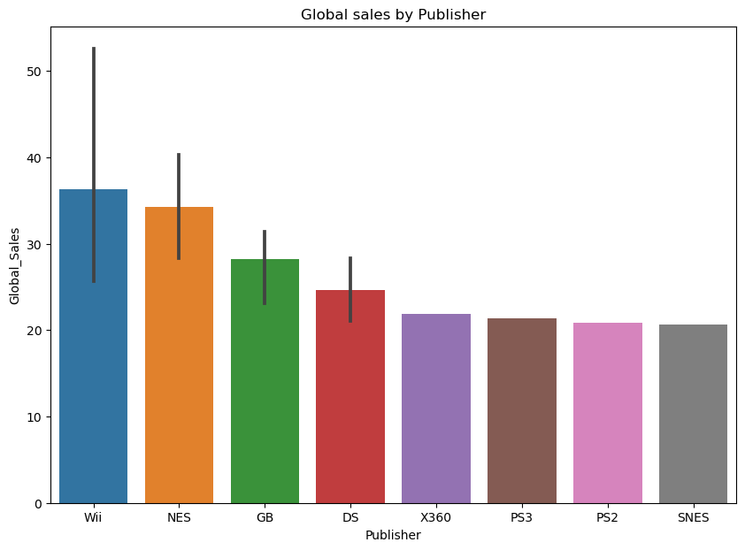
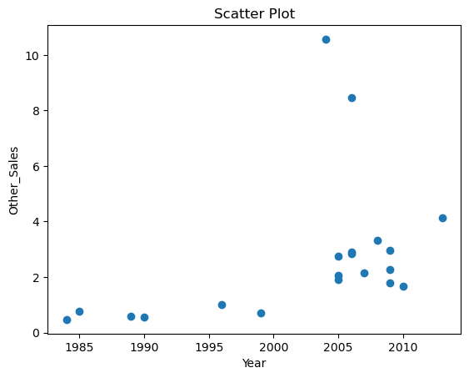
Data Visualization
Scatter Plot
Global Sales by Publisher

Slide 9
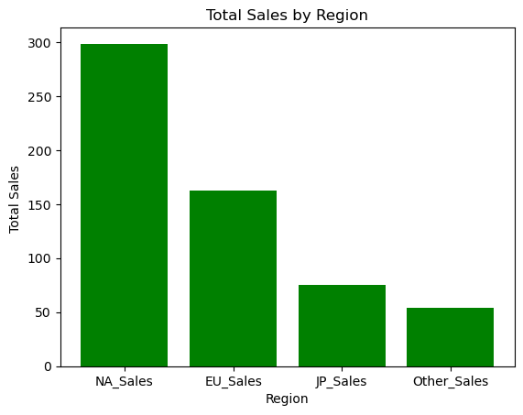
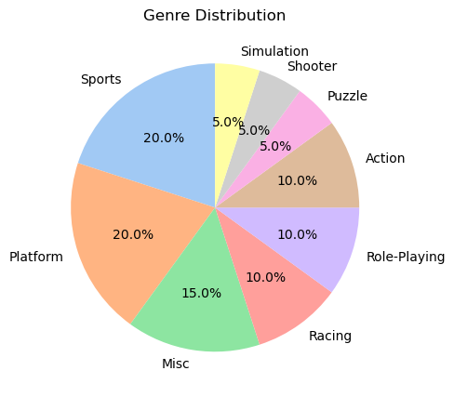
Data Visualization
Total Sales by Region
Genre Distribution

Slide 10
Accuracy Table
Model Name | Score
Linear Regression | 99%
Decision Tree | 95%
Random Forest | 97%
KNN | 94%

Slide 11
Conclusion
We have used four Machine learning algorithms to Analyze the Video Game sales data set.
The most used game Platform : Wii
Highest Video game Sales year : 2006
The most common Genre : Action

